Slide 1
Welcome Parents!
1st
Grade
Mrs. Barrows
Room 3

Slide 2
Hello
Welcome to First Grade
The heart of my teaching philosophy:
children succeed when school is a happy place to be
learning is fun
expectations are high
behavior SOARs
students know it’s okay to make mistakes
teacher is consistent
- home school partnership is vital
- reading and work work is a trusted must-do

Slide 3
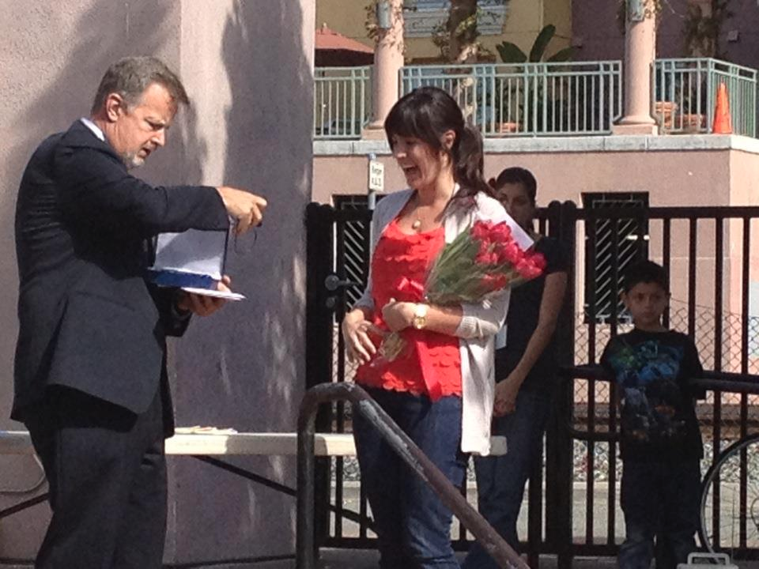
Hello
About Me
Graduated from UMass Amherst and worked in non-profit fundraising
Went back to school to earn a Master’s degree in Elementary Education
Taught 4th grade in Auburn before moving to San Diego, California
Worked 6 years at Monarch School. Taught 2nd and 3rd grade for 3 years there, featured on Ellen, 20/20, and the Today Show.
Welcomed my son to the world in 2013, decided to move home to Massachusetts
Moved to Medway & Taught 3rd grade last year at Henry P. Clough Elementary in Mendon
Thrilled to join the 1st grade team at McGovern!

Slide 4
Hello
A Typical Day…
8:35-8:50 Unpack/Handwriting Practice
8:50-9:20 Pledge, Shared Reading, & Calendar Meeting
9:20-10:00 Reader’s Workshop
10:00-10:15 Snack
10:15-10:45 Science/Social Studies
10:45-11:05 Open Circle/Word Work
11:05-11:50 Art, Gym, or Music
12:00-12:30 Lunch
12:40-12:55 Recess
1:00-1:45 Writer’s Workshop
1:45-2:45 Math
2:45-3:05 Pack Up/Teacher Read Aloud

Slide 5
Hello
Curriculum
Everyday Mathematics
Reader’s Workshop
Writer’s Workshop
Spelling & Word Study
Open Circle
Handwriting
Technology
Science
Social Studies

Slide 6
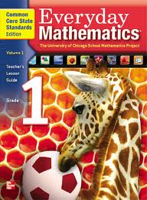
Hello
Math
A HomeLink will be sent home at the start of each unit. It will keep you up to date on upcoming math vocabulary, homework help, and a clear idea of what your child will be learning for the next few weeks.

Slide 7
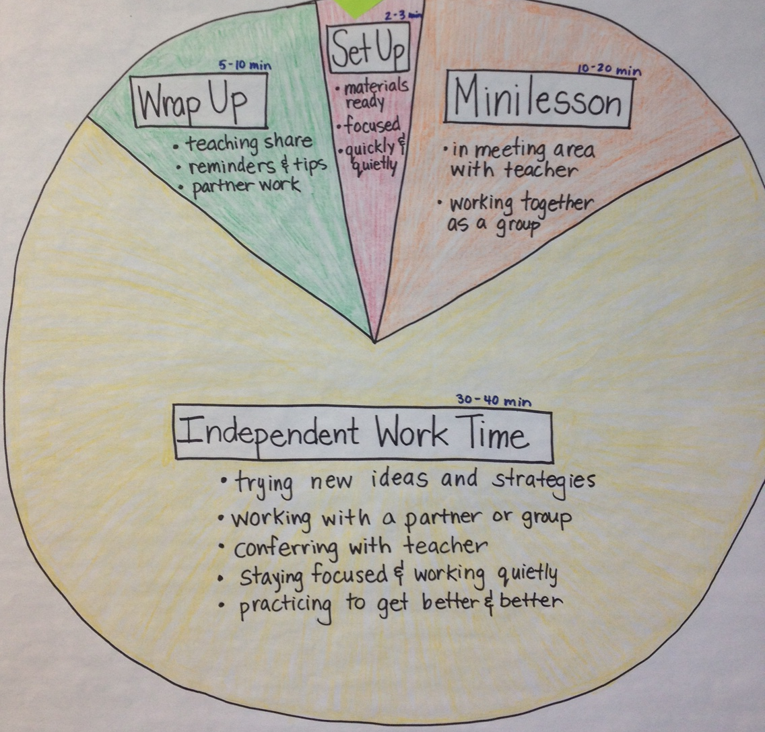
Hello
Reader’s Workshop

Slide 8
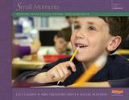
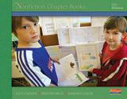
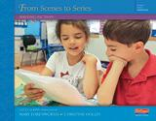
Writer’s Workshop Lucy Calkins Units of Study
Hello
Small Moments
Nonfiction Chapter Books
Writing Reviews
From Scenes to Series

Slide 9
Hello
Science
Our Science Program curriculum includes:
Living and non-living things
Properties of matter
Life cycles of frogs
Habitats
Balls and ramps

Slide 10
Hello
Social Studies
Our Social Studies curriculum includes:
Chronology and Time
Society/Diversity/Commonality
Earth i.e. direction, poles, equator, continents, oceans
Places and Regions i.e. map skills
Economics i.e. trade and money
Authority and Responsibility of School and Classroom Rules
Principles and Practice of American Government

Slide 11
Hello
Spelling & Word Study
Phonics skills will be taught during word work time.
Lists will be sent home each week to be practiced at home and online
Students will practice their “snap words” with little booklets
Spelling tests will be administered every Friday in the tech lab beginning October 16th.
Different first grade classes may have different words

Slide 12
Hello
Open Circle
Open Circle is our school system’s social competency program.
Our classroom meets as a group each week.
Some of the common language used in the program is:
Calm breathing
Flower Breathing
Double D (Dangerous or Destructive)
Annoying behaviors
Non-negotiable
“I don’t like it when you____because____.”

Slide 13
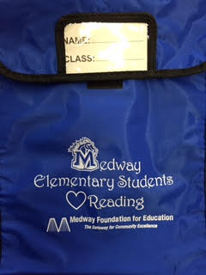
Hello
Homework
Nice and Neat: Write these words in alphabetical order…or reverse alphabetical order! | Bubble Letters: write your spelling words in big bubble letters. | Click, Clack, Moo: Type the words on a computer or ipad…don’t forget to change the font!
Messy Learning: Use shaving cream or a tray of salt and practice your spelling words (and handwriting) on the table. | Somewhere over the Rainbow: Write the words in rainbow colors or on your driveway in chalk. | All in Knots: Use rope, pipe cleaners, yarn, cooked spaghetti, or even a shoelace to make each spelling word.
Spell Dough: Use play dough to make your words into 3D masterpieces! Roll a piece of dough into a snake, form the word, and then trace over it with your finger | Opposite Day: Practice writing your spelling words with the hand you don’t normally write with. | Hopscotch: Make a hopscotch board outside and write spelling words instead of numbers. Hop to a word and spell it while hopping on one foot.
Medway first graders should expect 30 minutes of homework per night.
15 MINUTES OF READING
Starting October 5th, book bags will go to and from school Monday-Friday
Incredibly important that they are cared for and returned daily.
5 MINUTES OF WORD STUDY
- Starting October 5th, students will take home a word list, word cards, and a menu of kinesthetic spelling activities
- All words and activities can be accessed online
10 MINUTES OF MATH
- Starting October 5th, Home Links from the Everyday Math curriculum will come home Monday-Thursday and will need to be returned the next day.
- NO TEARS ALLOWED!

Slide 14
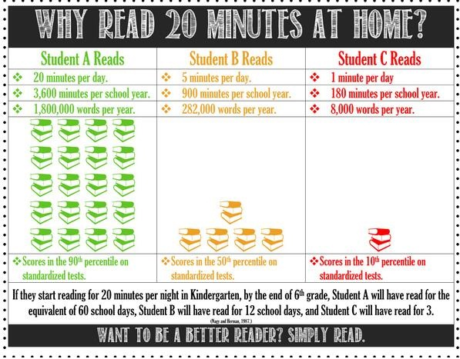

Slide 15
Hello
Class Dojo

Slide 16
Hello
Get Involved
Bookmark the blog: mcgovenroom3.weebly.com
Email me anytime: tbarrows@medwayschools.org
Stay tuned for parent visit & volunteer events
-pumpkin math on Halloween
-Thanksgiving assembly
- frog research projects in June
Check out our classroom wishlist tree!

Slide 17
Hello
Questions?

